Slide 1


INTRO TO QUANTUM COMPUTING
LECTURE #23
Quantum Hardware:
Trapped ion qubits
David Wong-Campos
04/25/2021
© 2020 The Coding School

Slide 2
Born in Peru
Undergrad in Mexico
PhD in Physics, quantum computing (University of Maryland)
Worked for two years at IonQ (a quantum computing startup)
Currently a Postdoc in neuroscience at Harvard
Short bio:
- 2 -
© 2020 The Coding School

Slide 3
tldr: Trapped ion qubits
Take mother nature’s qubits (atoms) and engineer around them
- 3 -
© 2020 The Coding School

Slide 4
Why atomic ions?
The most ideal and clean quantum system. Based on well understood Physics
Best detection fidelity: 99.995(6)%
Best single qubit gate fidelity: 99.9934(3)%
Best Two qubit gate fidelity: 99.9(1)%
Excellent coherence* (>10 min)
Reconfigurable: computation, simulation etc.
Full connectivity
* Time it takes before it stops having quantum properties
- 4 -
© 2020 The Coding School

Slide 5
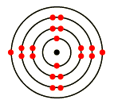
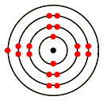
What is an atomic qubit
Trapping charged atoms is relatively easy (done since the 50’s)
Step 1: Find an atom with two outer electrons
Step 2: Ionize it
Step 3: Confine it in an electromagnetic trap
- 5 -
© 2020 The Coding School

Slide 6
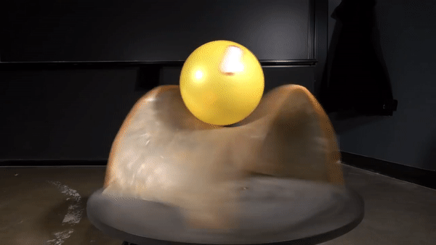
How do the traps work?
Positively charged particles are repelled by electric fields
Certain configurations do a better job:
… but not quite
Electric field
Force
+q
Electric field
Electric field
+q
Solution: Make them rotate/oscilate !
Reality:
Electric field
Electric field
+q
- 6 -
© 2020 The Coding School

Slide 7
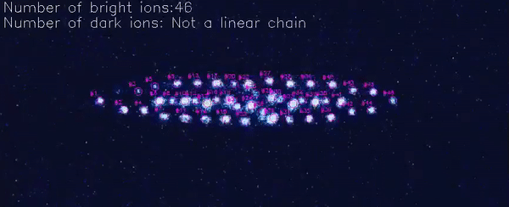
How to get more qubits
One could use the same principle for trapping many of them:
- 7 -
© 2020 The Coding School

Slide 8
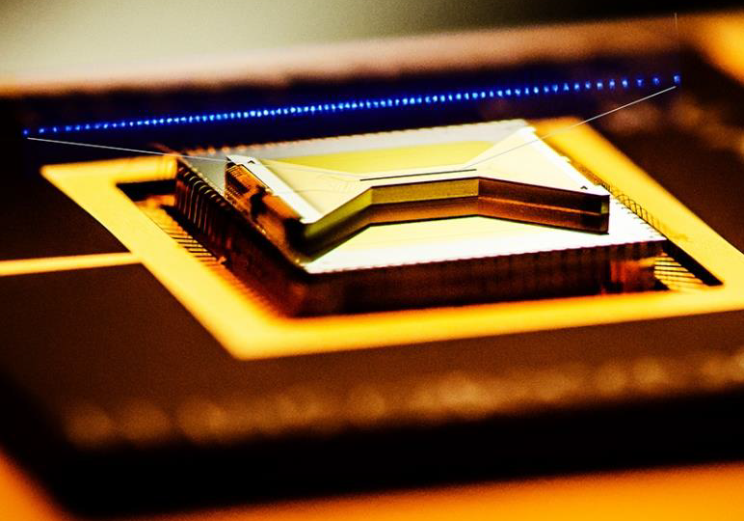
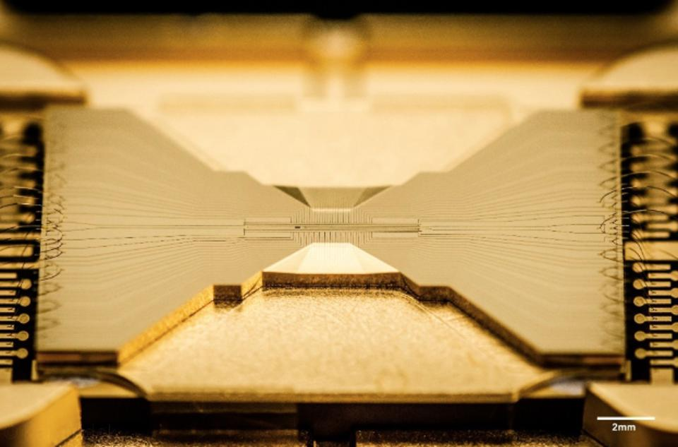
How they look like in real life
- 8 -
© 2020 The Coding School

Slide 9

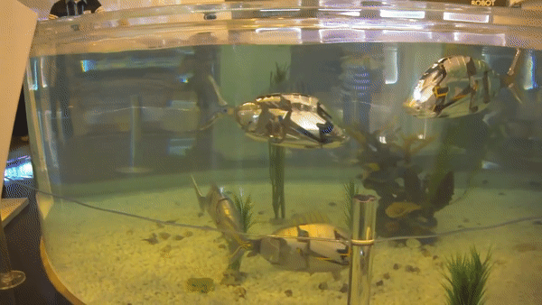
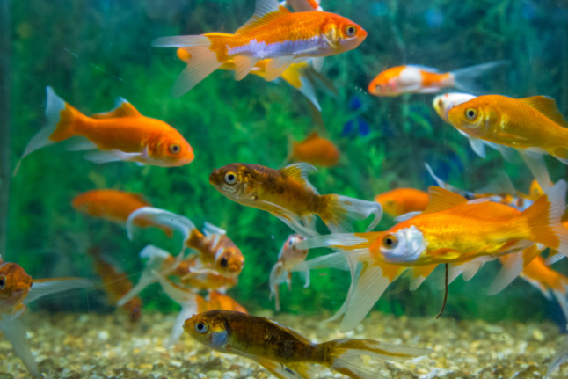
An analogy
ACTUALLY:
- 9 -
© 2020 The Coding School

Slide 10
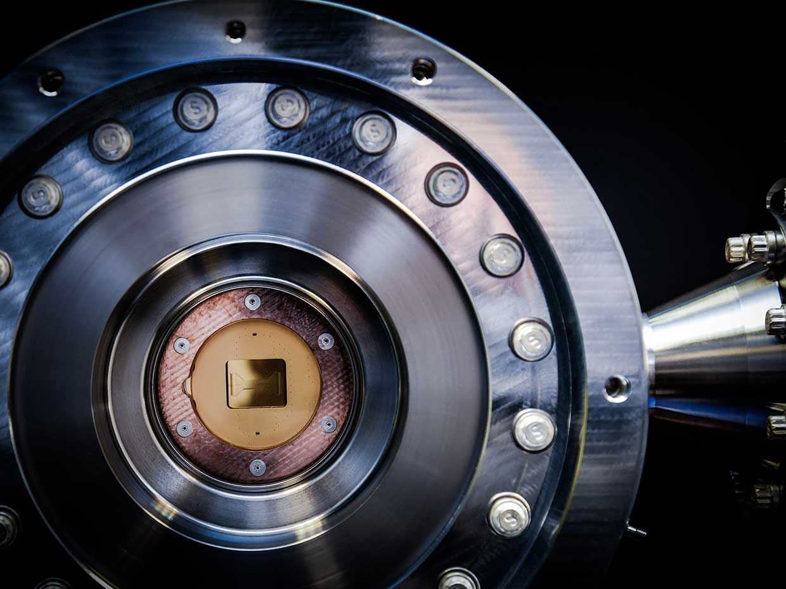
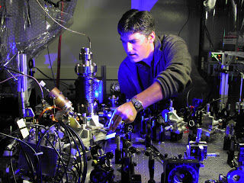
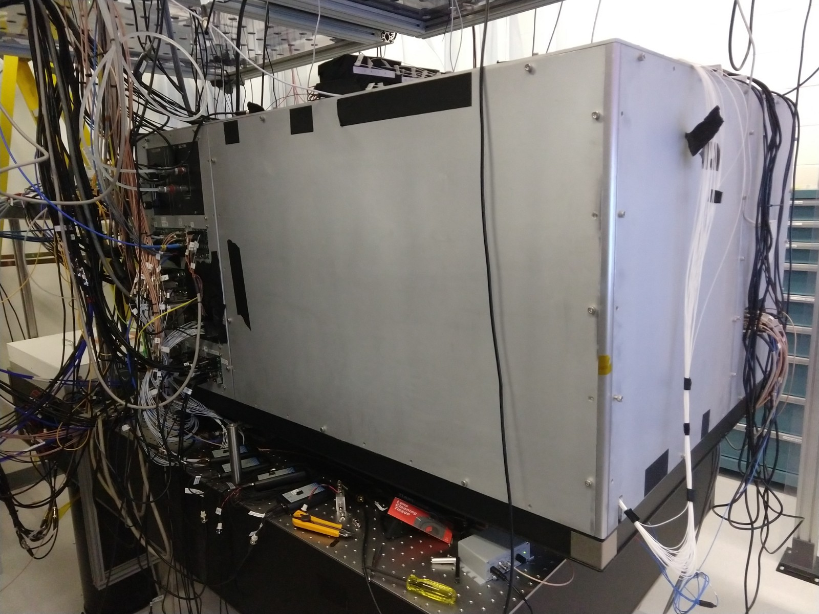
How do we operate the qubits?
Equipment:
Vacuum chambers
Lasers!
Control electronics
- 10 -
© 2020 The Coding School

Slide 11
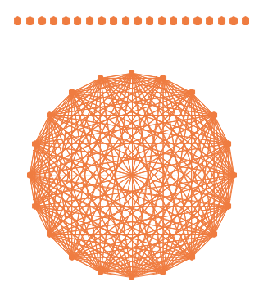
How are the qubits connected
All the atoms “feel” everybody else They are charged*
*Like charges repel each other
- 11 -
© 2020 The Coding School

Slide 12
How do you control them?
Single qubit gates allows the control of “how much” 0 or 1 each qubit have.
Trapped ion qubits are pretty much two level systems for practical purposes*
|Ψ⟩ = a₀|0⟩ + a₁|1⟩
τ
Prob(↑|↓)
Preparation
Laser
Measurement
1
0.8
0.6
0.4
0.2
0
0
50
100
150
200
250
300
350
400
τ (μs)
Up to really good approximations!
Fastest gates are usually around 5 microseconds
- 12 -
© 2020 The Coding School

Slide 13
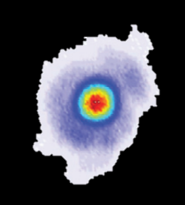
How do you perform gates?
Push individual ions with lasers
|0⟩
|0⟩
- 13 -
© 2020 The Coding School

Slide 14
How do you perform gates?
Push individual ions with lasers
|0⟩
|0⟩
- 14 -
© 2020 The Coding School

Slide 15
How do you perform gates?
Push individual ions with lasers
|0⟩
|1⟩
- 15 -
© 2020 The Coding School

Slide 16
How do you perform gates?
Push individual ions with lasers
|0⟩
|1⟩
Average gate time: 5-25 microseconds
If that push depends on whether the ion is in the 0 or 1 state, it allows quantum gates!
EXTRA CREDIT: WHAT HAPPENS IF THE ATOMS ARE IN A SUPERPOSITION OF |0⟩ AND |1⟩ ??
- 16 -
© 2020 The Coding School

Slide 17
Pros and Cons
Pros:
Excellent quantum properties
Traps are made with known techniques
Laser and photonics technology is mature enough
High quality gates and readout
Cons:
Slow operations (for now)
Needs vacuum
- 17 -
© 2020 The Coding School

Slide 18
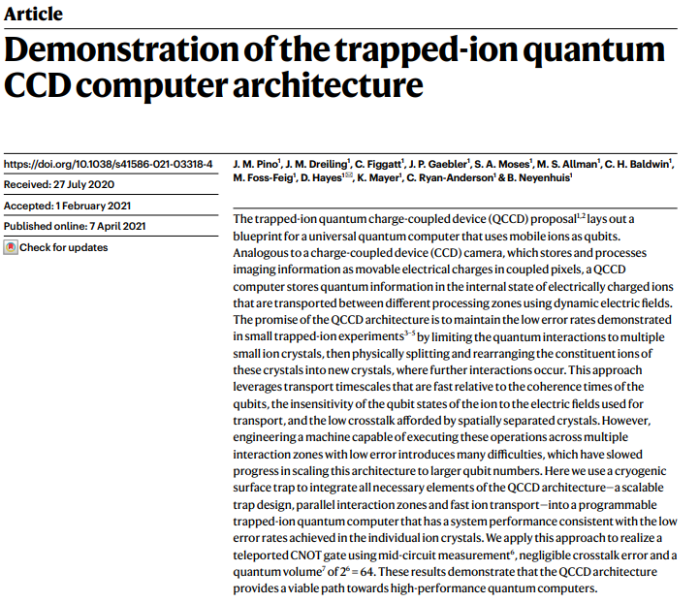
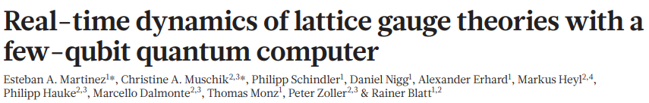
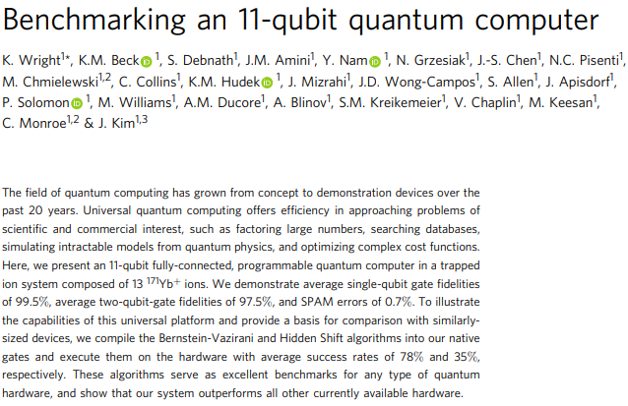
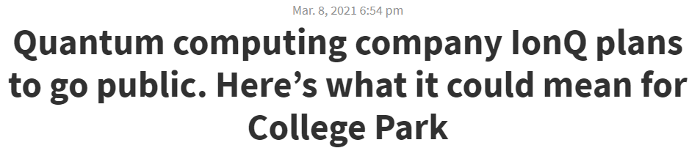
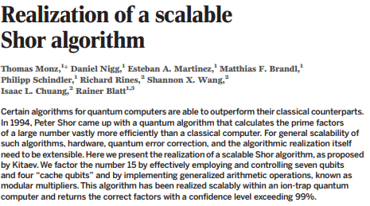
Breakthroughs
- 18 -
© 2020 The Coding School

Slide 19
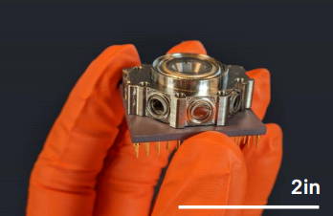
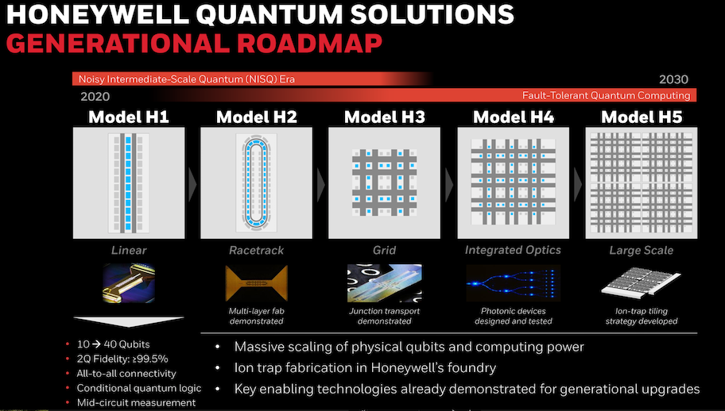
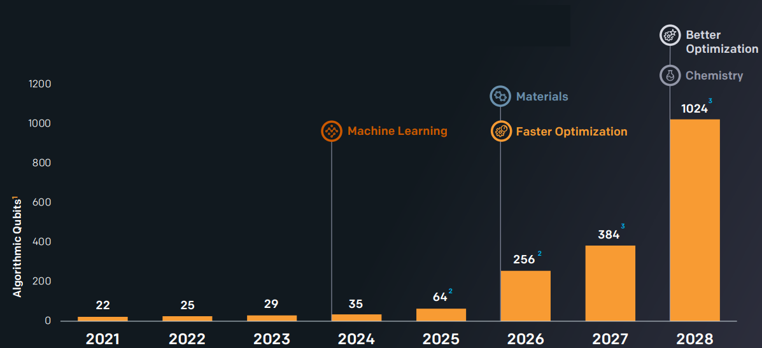
Ongoing research and developments
Scaling to more qubits
Achieving error correction and fault tolerance
First quantum Unicorn!
- 19 -
© 2020 The Coding School

Slide 20
INTRO TO QUANTUM COMPUTING
LECTURE #23
Quantum Hardware:
Solid-state defects centers
Eric Bersin, MIT PhD Student
04/25/2021
© 2020 The Coding School

Slide 21
© 2020 The Coding School
All rights reserved
Use of this recording is for personal use only. Copying, reproducing, distributing, posting or sharing this recording in any manner with any third party are prohibited under the terms of this registration. All rights not specifically licensed under the registration are reserved.
© 2020 The Coding School

Slide 22
tldr: Solid-state defect centers
Take a solid material, and add a defect –
ok for quantum computing, great for quantum internet
- 22 -
© 2020 The Coding School

Slide 23

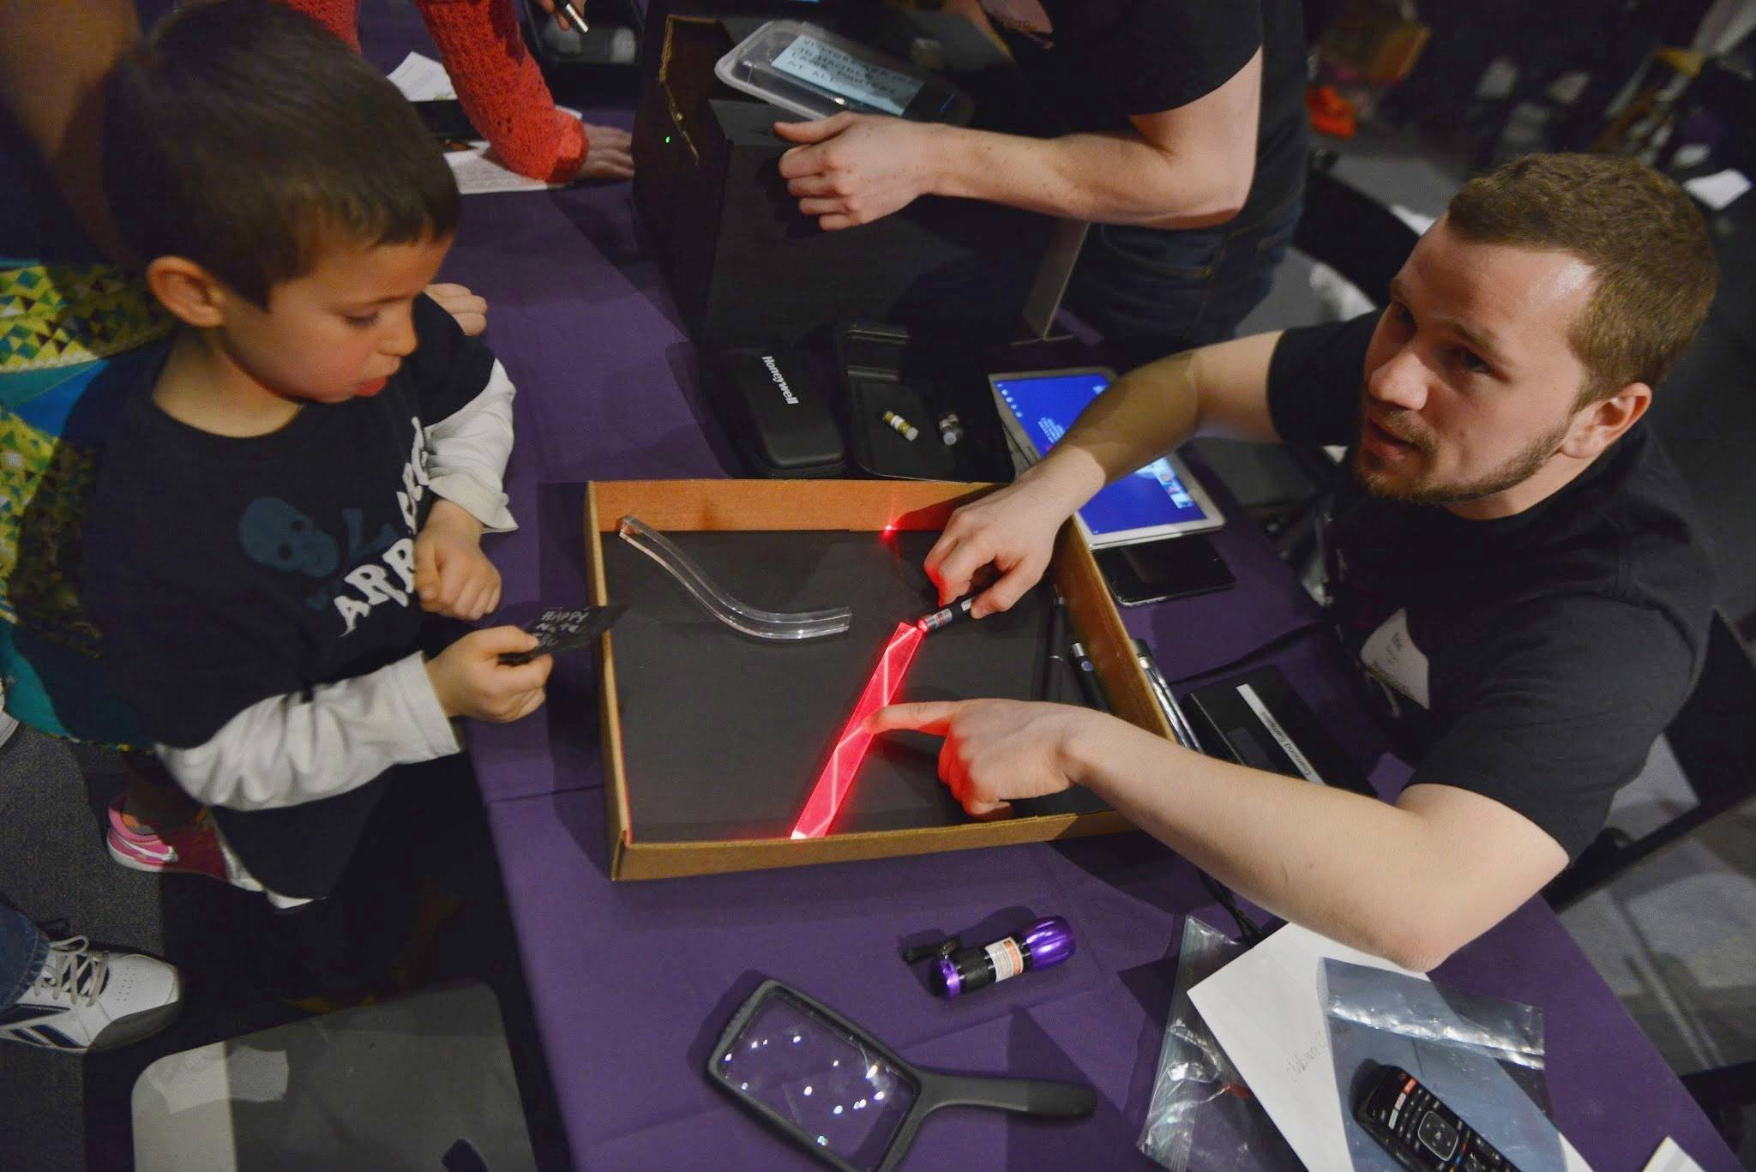
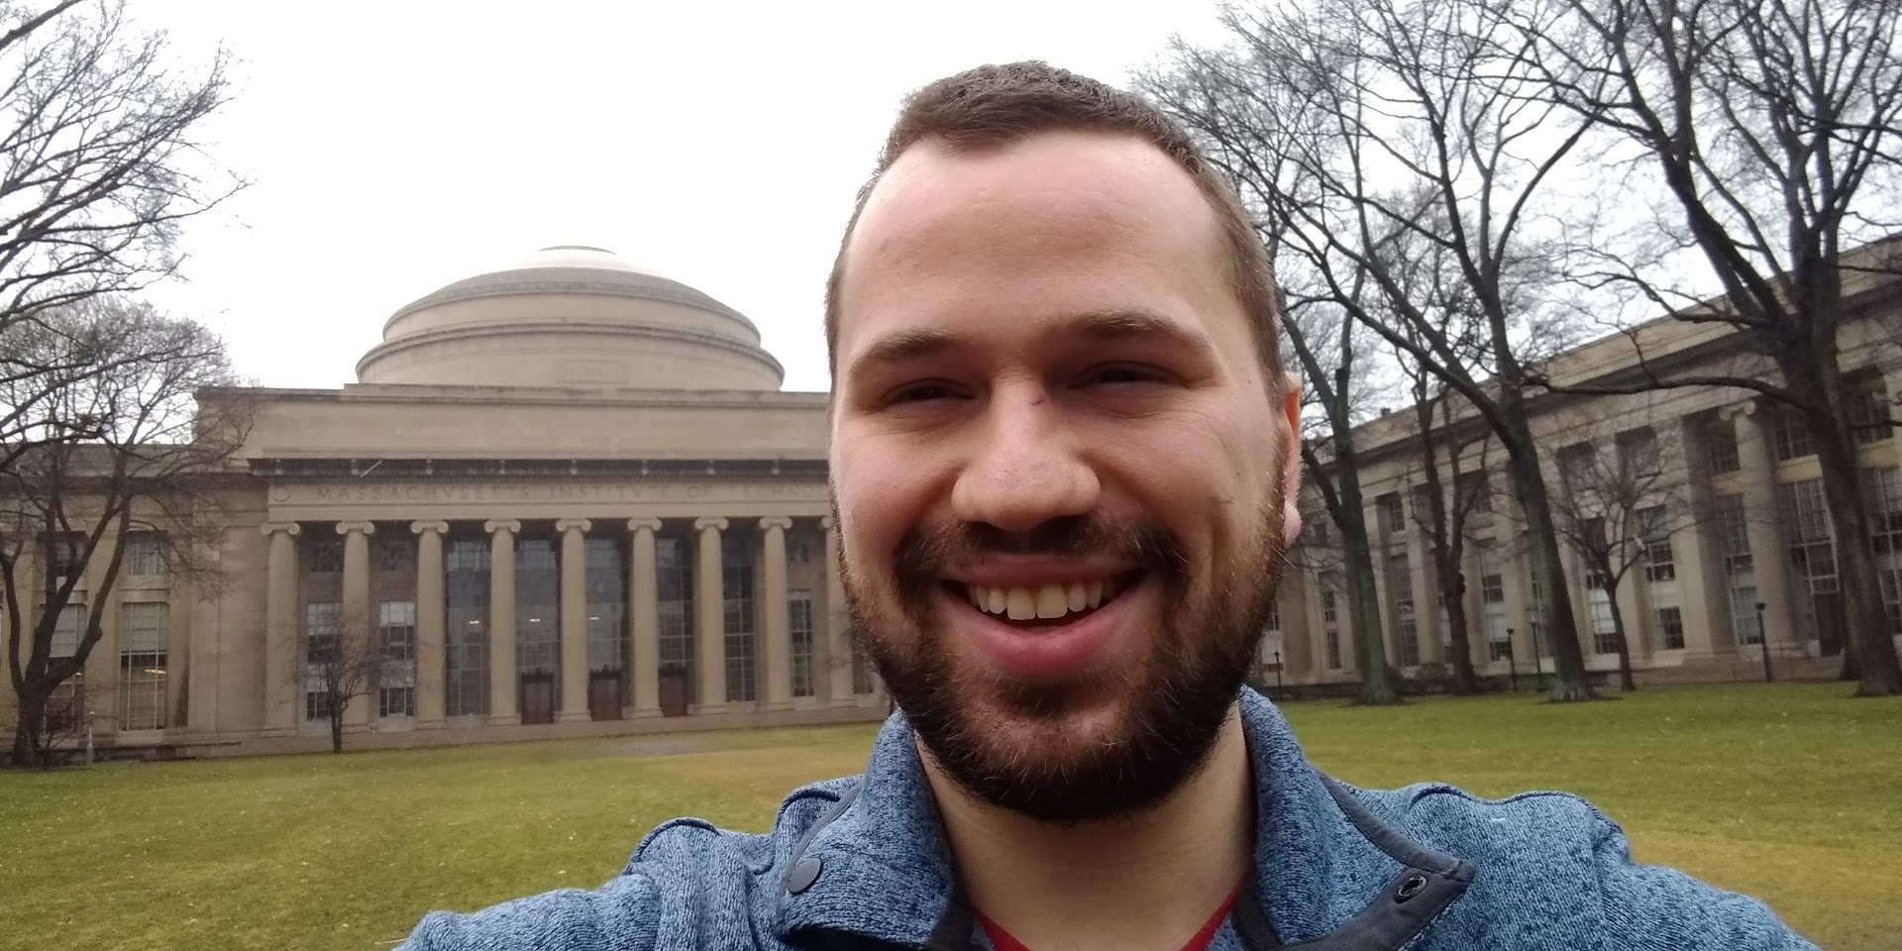
Who am I
From Long Grove, Illinois
Studied biomedical engineering in college
Found out quantum mechanics super cool AND useful!
Now MIT grad student in electrical engineering
My dog, who likes hiking
MIT Dome!
- 23 -
© 2020 The Coding School

Slide 24

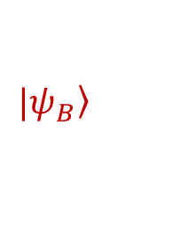

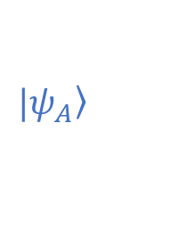
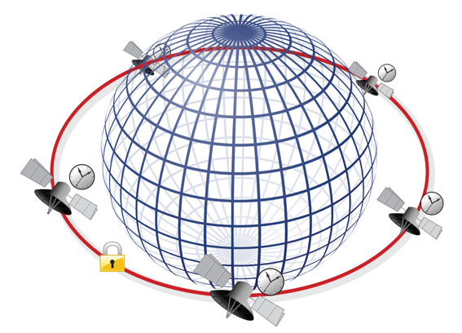
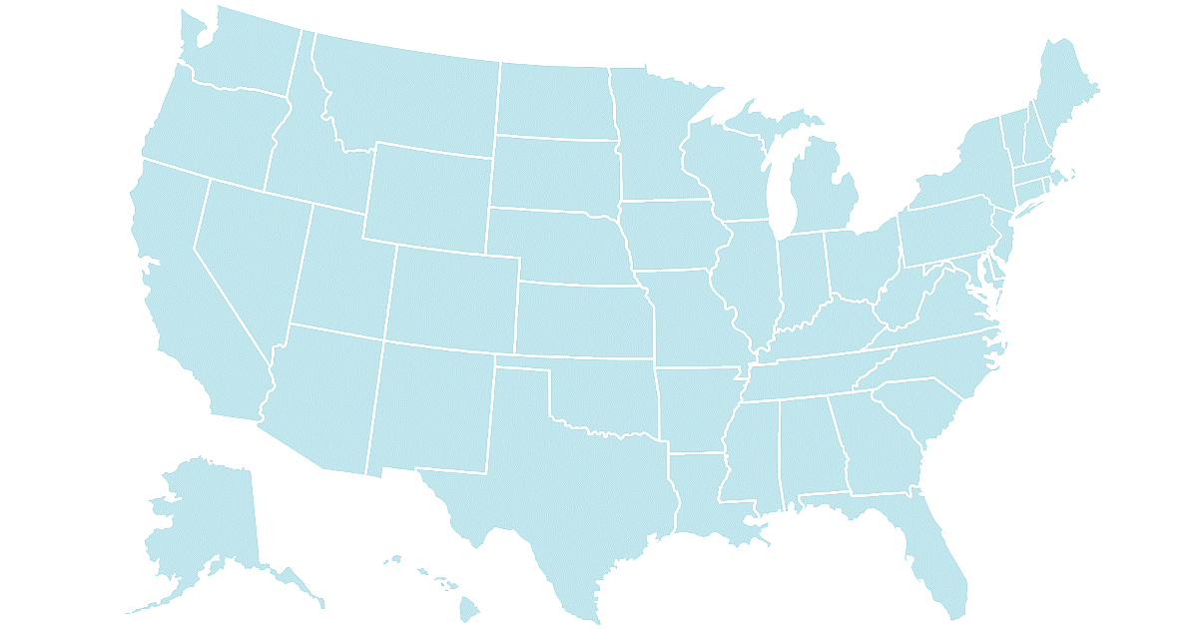


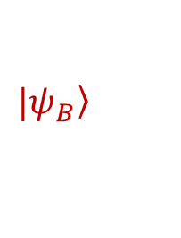

What is the quantum internet?
Quantum internet/networking = sending quantum states over long distances
Quantum cryptography 🡪 100% secure secret sharing
Quantum-enhanced sensing
Connecting quantum computers!
entanglement
Quantum information can be sent long distances using light pulses – called photons
Gravitational wave detection
- 24 -
© 2020 The Coding School

Slide 25
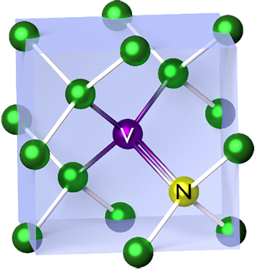
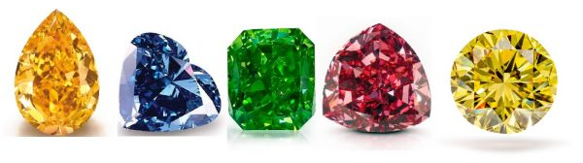
What is a defect center
Materials like diamond have a crystal structure
Defect center qubit: make a “defect” – replace one of the atoms with something else
Acts like a trapped ion, but protected by the surrounding material
Lots of different “species” of defects, in lots of different materials!
Most popular of these is the “nitrogen vacancy” defect in diamond
- 25 -
© 2020 The Coding School

Slide 26
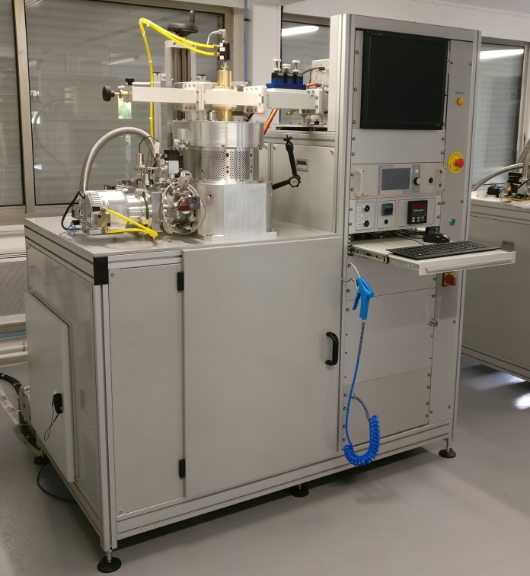
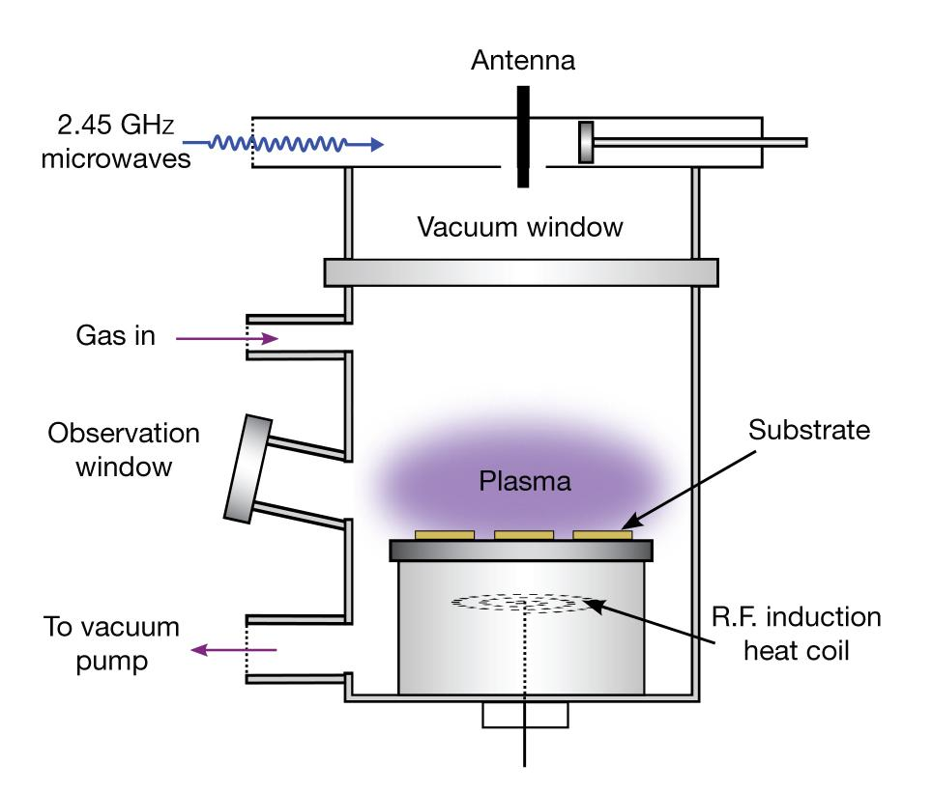
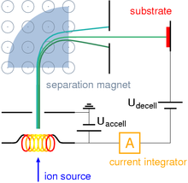
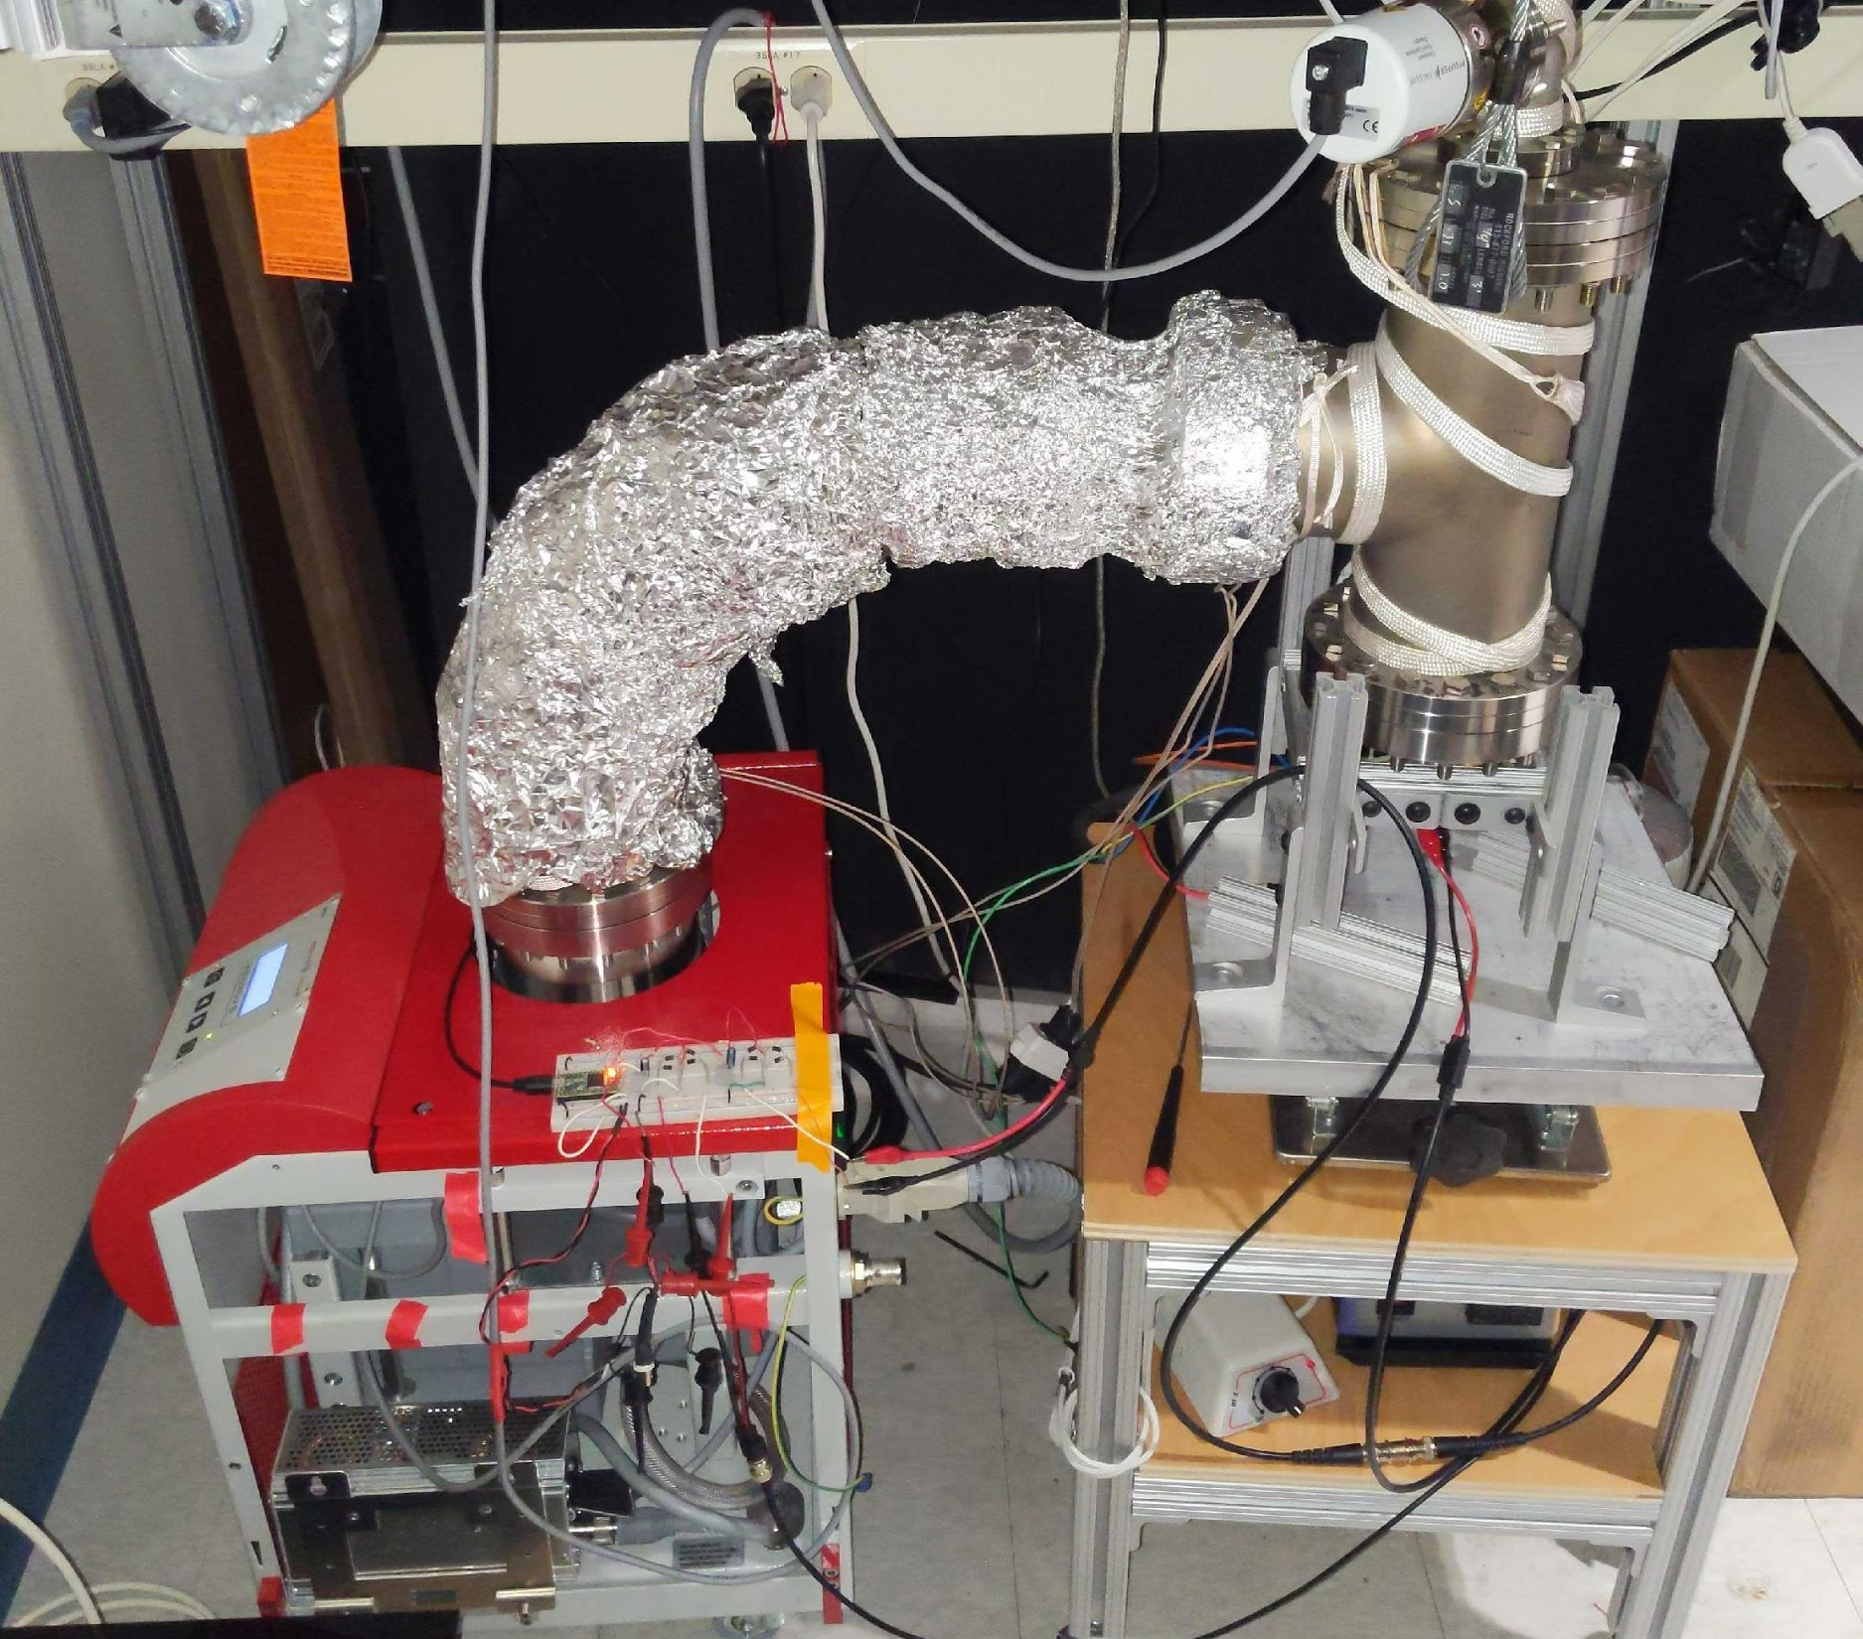
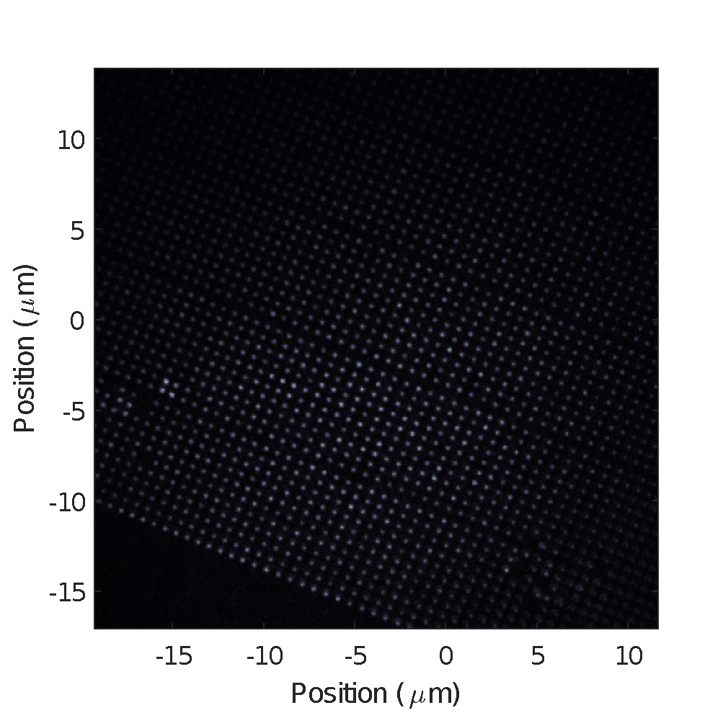
How do we make them
Step 1) Grow a diamond
Step 2) Implant ions
Step 3) Heat up diamond (called “annealing”) to form defects!
- 26 -
© 2020 The Coding School

Slide 27
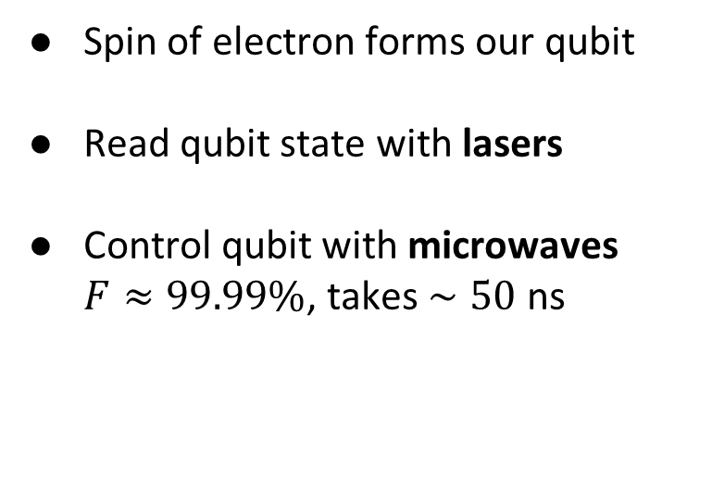
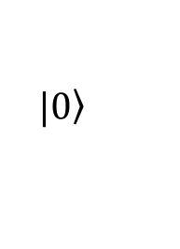
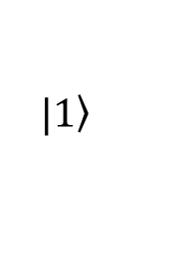
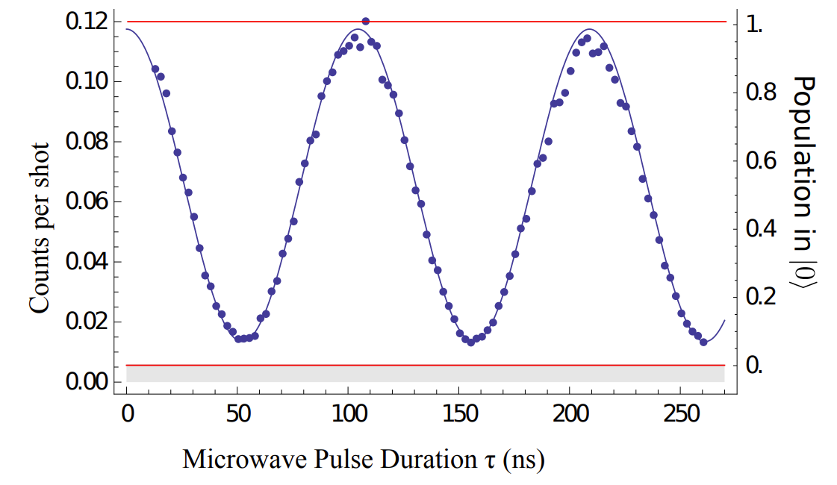
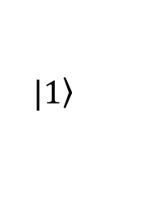
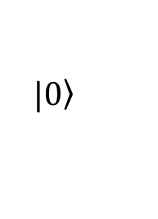
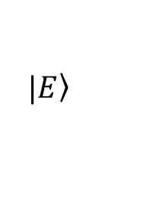
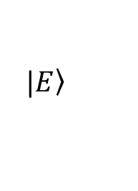
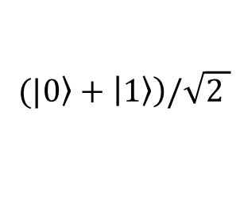
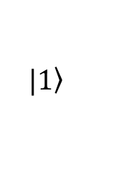
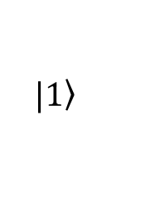
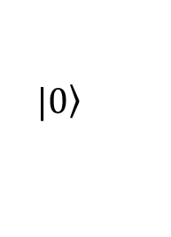
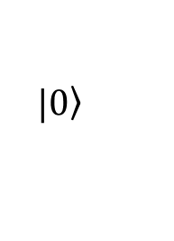
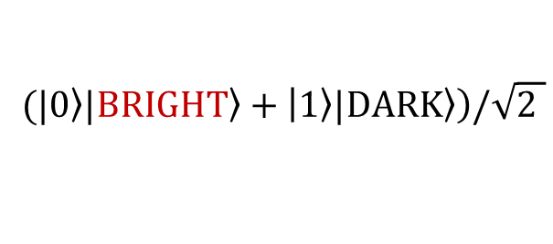
How do we use them as qubits
Microwaves
Bonus: What happens if we prepare a superposition, then apply a laser?
X
Entanglement between spin and light!
BRIGHT
DARK
- 27 -
© 2020 The Coding School

Slide 28
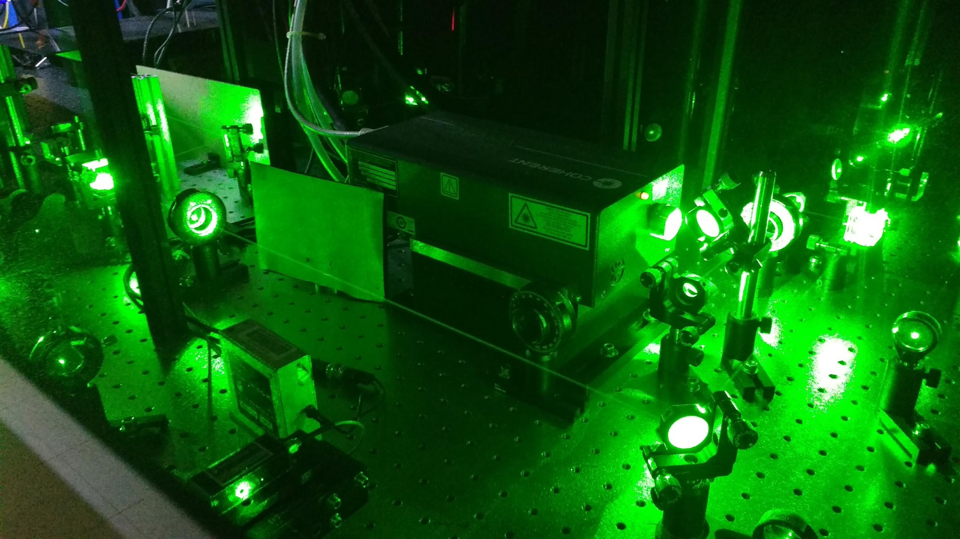




How do we operate the qubits
Lasers for reading qubits
Microwaves to control qubits
Cryostat for ~kelvin temps
- 28 -
© 2020 The Coding School

Slide 29







How do we entangle the qubits
Close qubits: Magnetic field interaction
Far qubits: Light-mediated gate
Bright
Dark
Special mirror: 50% Reflect, 50% Transmit
Low Energy
High Energy
Photon
Detector
Click!
One click =
CZ Gate
- 29 -
© 2020 The Coding School

Slide 30



Putting them on a chip – fabrication!
Qubits already in material
Can carve wires out for making integrated circuits
Oxygen Plasma
Can easily put many qubits on a chip
Can collect light and route on chip, just like electrical circuits
- 30 -
© 2020 The Coding School

Slide 31

Collecting light for quantum internet
Ion in vacuum
Ion in material
Light emits in all directions
Light “trapped” in material
Only small percentage collected by fiber optic cable
Quantum Internet
Collect up to 50% of light!
- 31 -
© 2020 The Coding School

Slide 32

Pros and Cons
Cons:
Requires cooling to mK – K temperatures
Connecting lots of qubits challenging
Materials sometimes inconsistent
- 32 -
© 2020 The Coding School

Slide 33




Breakthroughs
- 33 -
© 2020 The Coding School

Slide 34




Ongoing research
Hunt for new species of defects in new materials
Improvements in host materials (to further improve coherence)
New fabrication – better light-controlling circuitry
Faster, higher fidelity two-qubit gates
Putting even more qubits on one chip
Lead defect??
We grew a very ugly diamond
🡨 Thousands of qubits on one chip!
- 34 -
© 2020 The Coding School

Slide 35
Additional Reading
Quantum internet: A vision for the road ahead: https://science.sciencemag.org/content/362/6412/eaam9288
The Quantum Internet, J. Kimble: https://arxiv.org/abs/0806.4195
Quantum network is step towards ultrasecure internet: https://www.nature.com/articles/d41586-021-00420-5
Toward an unhackable quantum internet: https://news.harvard.edu/gazette/story/2020/04/researchers-demonstrate-the-missing-link-for-a-quantum-internet/
Scaling up the quantum chip: https://news.mit.edu/2020/scaling-quantum-chip-0708
- 35 -
© 2020 The Coding School

Slide 36
© 2020 The Coding School
All rights reserved
Use of this recording is for personal use only. Copying, reproducing, distributing, posting or sharing this recording in any manner with any third party are prohibited under the terms of this registration. All rights not specifically licensed under the registration are reserved.
© 2020 The Coding School

Slide 37
INTRO TO QUANTUM COMPUTING
LECTURE #23
Quantum Hardware:
Photonic qubits
Stefan Krastanov
04/25/2021
© 2020 The Coding School

Slide 38
tldr: Photonic qubits
Use small packets of light to carry quantum information. They are resilient to noise, but difficult to work with.
- 38 -
© 2020 The Coding School

Slide 39
The Good Things About Photons
Optical hardware does not need to be cooled.
It also happens to be ridiculously fast.
- 39 -
© 2020 The Coding School

Slide 40


Thermal noise is a problem
- 40 -
© 2020 The Coding School

Slide 41

Thermal noise vs Photonic qubits
- 41 -
© 2020 The Coding School

Slide 42
The Bad Things About Photons
They really do not want to interact with each other.
- 42 -
© 2020 The Coding School

Slide 43

Light does not interact with itself
- 43 -
© 2020 The Coding School

Slide 44

Nonlinear optics in special materials
- 44 -
© 2020 The Coding School

Slide 45

Nonlinear optics in special materials
- 45 -
© 2020 The Coding School

Slide 46

We might just end using atoms/defects
- 46 -
© 2020 The Coding School

Slide 47
Photonic Chips
To manipulate states of light.
- 47 -
© 2020 The Coding School

Slide 48



A chip with waveguides instead of wires
- 48 -
© 2020 The Coding School

Slide 49

Storing light on a chip
- 49 -
© 2020 The Coding School

Slide 50


Storing light on a chip
- 50 -
© 2020 The Coding School

Slide 51


Storing light on a chip
- 51 -
© 2020 The Coding School

Slide 52
Pros and Cons
Pros:
Comes on a chip
Compatible with existing fabrication infrastructure
Extremely fast
Room temperature
The only way to send quantum states between distant devices
Cons:
Gates between qubits are very difficult as photons simply do not interact with each other
- 52 -
© 2020 The Coding School

Slide 53
© 2020 The Coding School
All rights reserved
Use of this recording is for personal use only. Copying, reproducing, distributing, posting or sharing this recording in any manner with any third party are prohibited under the terms of this registration. All rights not specifically licensed under the registration are reserved.
© 2020 The Coding School

